Slide 1
Malaysia Airlines Flight MH370
Public Relations for Crisis Communications
Kara Jewell

Slide 2
Overview of Crisis
Flight MH 370 disappeared on March 8
Kuala Lumpur to Beijing with 227 passengers and 12 crew on board
Malaysia Airlines
Malaysian Government owns 70% stake in company
CEO Ahmad Jauhari, PM Najib Razak, TM Hishammuddin Hussein
More than 26 countries have joined in on SAR across 30 million sq. mi.
Ketchum Public Relations
March 15
John Bailey
aviation expert and head of Ketchum Icon
Team of 7
Notes:
John Bailey- Singapore
ICON aquired in 2005

Slide 3
Timeline
March 8: Authorities claim to have spotted a 12-mile long oil slick between Malaysia and Vietnam
March 8: Two people listed as passengers on the missing Malaysia Airlines jet turned out not to be on the plane
March 9: Malaysia military says the flight turned around
March 11: Malaysia Government says MH370 may have flown hundreds of miles west
March 13: US says plane flew 4 hours after dropping Radar
March 15: Police search Pilot’s home
March 16: Reveled last message was “All right, good night.”
March 20: Australia finds two objects in Indian Ocean
March 24: Malaysia Airlines sends texts to families
April 1: Final words from cockpit-'Good night Malaysian three seven zero‘
Full final transcript released

Slide 4
Timeline
April 2: All passengers cleared from suspicion
April 3: Australia PM- MH370 is most difficult search ever undertaken
April 5: Chinese ship detects possible black box
April 7: Australian Navy detects possible black box signal
April 10: Australian aircraft picks up another ‘ping’ but determined unrelated
April 11: Australian PM says confident underwater signals are coming from missing planes’ recorders- but is 15,000 ft. deep

Slide 5
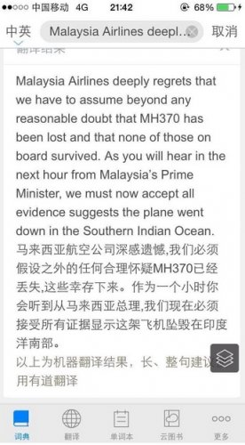
Tell the truth
The families were sent the text message to the right
Sent one hour before PM Najik Razak held a press conference and told world.
Notes:
Let the public know what’s happening & provide an accurate picture of the company’s character, ideals, practices
There was no truth to tell
No clear voice

Slide 6
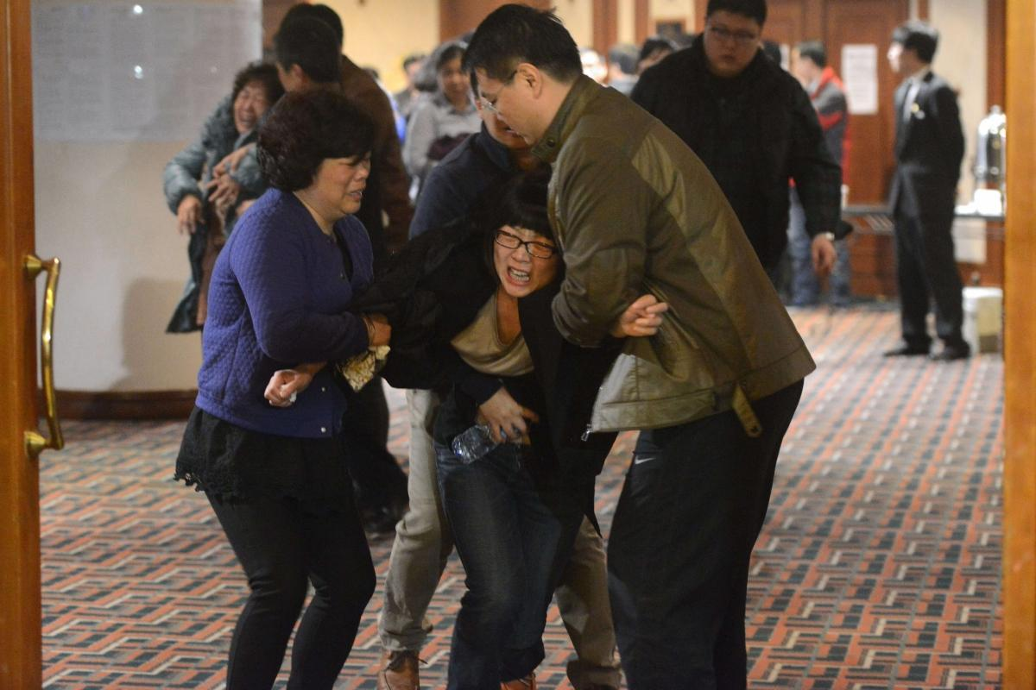
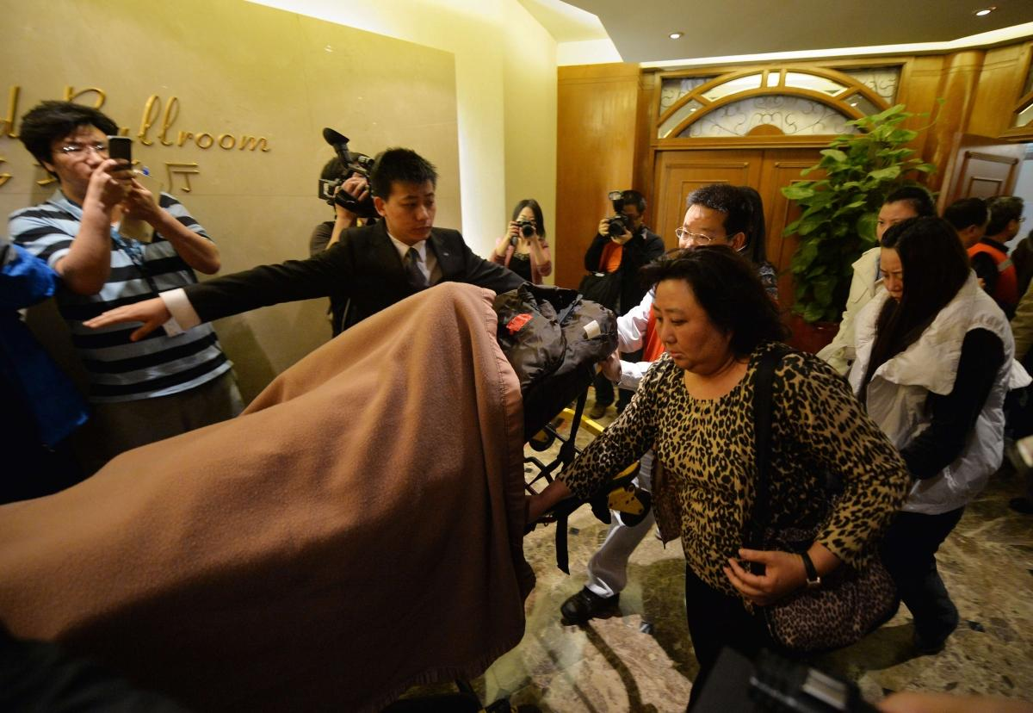
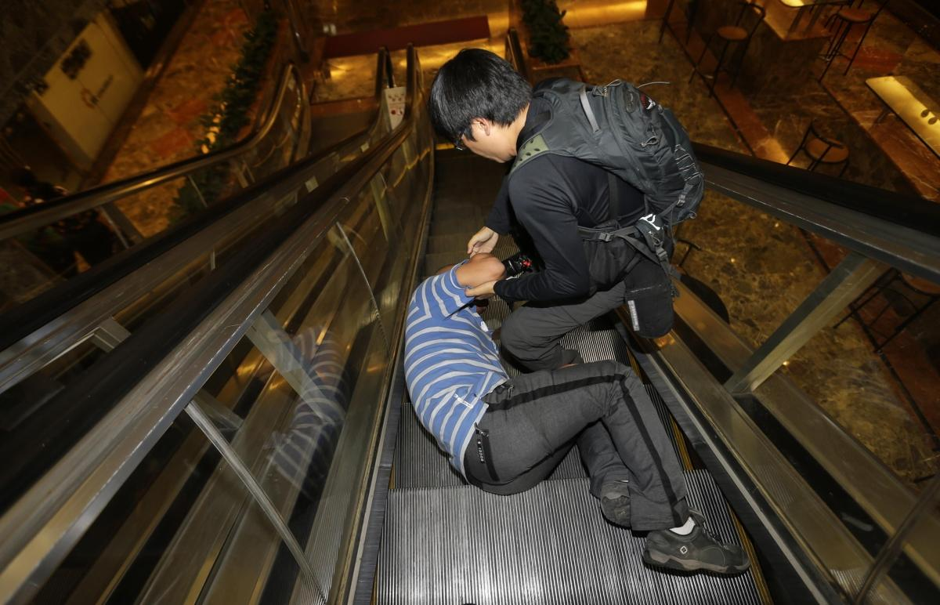
What the public saw

Slide 7
Prove it with action
‘‘Who’s to say they couldn’t have located the plane the day that it happened. A lot of information seemed to have been withheld and took a very long time to get through”
Danica Weeks, Wife of Paul Weeks
No one clear voice
Airline, government and military
China’s state press agency Xinhua
"It is known to all that inaccurate, or at least incomplete, information led the initial search in the South China Sea nowhere and thus that precious time was wasted.”
Notes:
As difficult as it may sound, these groups should have issued one joint statement per day
First, they communicated without the facts. Instead of waiting for concrete information on the fate of the plane, the government disseminated facts and figures that were neither verified nor correct.
They didn’t say what they were doing

Slide 8
Listen to the customer
Families of those on board issued a response from Bejing
“...From March 8, when they announced that MH370 lost contact, to today, 18 days have passed during which the Malaysian government and military constantly tried to delay and deceive the passengers’ families and cheat the whole world ... Malaysian Airlines, the Malaysian government and military are the real executioners who killed them (the passengers and crew).”
Feelings and emotions can be more valuable than speed
Media had easy access to families when they received the text of news
"It’s not about finding the plane, it’s about several hundred people whose lives are on hold. They are the audience”- Rob Jensen
Notes:
Crying family members amid the media makes for a great story for the media and a horrible story for your company.

Slide 9
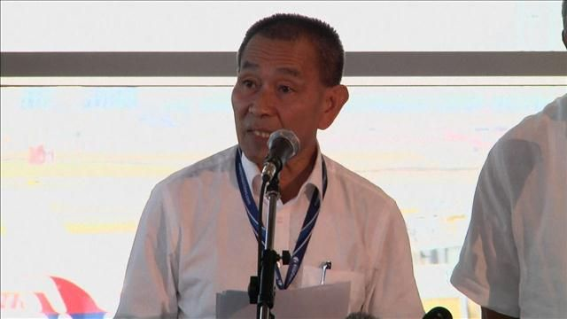
Manage for tomorrow
“Airlines can take up to six months to recover from what we call a 'market reputation issue' and ... we intend to do that quicker”
“Mr. Ahmad added that the airline has also "ratcheted'' up security internally since the incident. He didn't say how”
–WSJ
CEO Ahmad Jauhari
Notes:
Anticipate PR and eliminate practices that create difficulties. Generate goodwill. CEO Ahmad Jauhari
“We've got a lot of work to do. The airline obviously needs to get itself together.”
Airlines can take “up to six months to recover from what we call a 'market reputation issue' and ... we intend to do that quicker,” Ahmad Jauhari said.

Slide 10
Realize a company’s true character is expressed by its people
Indira Nair
Defends the company
Offers suggestions
DM Hishammuddin Hussein
He appears unsure of himself and lacks key facts
to support his statements
PM Najib Razak
Confusing statements that shifted from day to day
Notes:
Hishammuddin Hussein, Malaysia’s defense minister and acting minister of transportation, became an instant media source. From afar, particularly in the U.S. where most of the population is wired, he appeared unsure of himself and lacking key facts to support his statements. Malaysian Prime Minister Najib Razak added to the mystery with confusing statements that shifted from day to day.
The national carrier will make payments beyond the $5,000 already disbursed to relatives and arrange to fly them to the recovery areas, if they choose, once investigating authorities grant approval, Ahmad Jauhari Yahya, the chief executive of the airline told reporters in Kuala Lumpur.
Indira nair
While Malaysia Airlines has been criticised for its communications response to the disaster, the airline's former communications head defended its approach."I honestly don’t think the criticism is fair," Indira Nair told the Holmes Report. "Considering the complexity of what happened...what could the airline have done better?"Nair, who left the airline in 2010 and now runs her own consultancy, noted that Malaysia Airlines has been hamstrung by the Malaysian government's own uncomfortable communications response."The Malaysian government is not used to dealing with the international media, especially in situations like this," she said. "A crisis is not a rehearsal — you must do your preparation beforehand."While Nair said that Malaysia Airlines had a full suite of crisis plans in place, she noted that the airline had been severely tested by the involvement of other governments and organisations, and the unique nature of the situation.She also admitted that "little things could have been done better," particularly where the families of the missing where concerned. The airline, she added, had appeared overly reactive in the face of sustained criticism. The Malaysian government retains a large stake in Malaysia Airlines. As WSJ editor Adam Najberg noted in Mumbrella Asia earlier this week, “
Shaped by words and deed of own employees

Slide 11
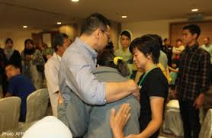
What they are doing well
Two caregivers per family, supporting 900 people
Press Releases often on company’s webpage
Daily live official press briefings
Australian PM Tony Abbot

Slide 12
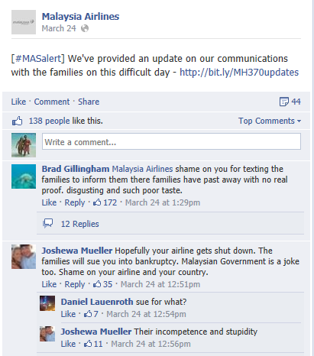
Social Media
Website
Grey and Press Releases
Pulled all promo content
#MASalert and #MH370
Links their company website on their posts
YouTube
Notes:
PRs that fails to detail the current state of the investigation
Hashtags
Sensitive to the subject of the missing flight and they send their condolences to the families affected by the incident.
Youtube
March 23rd- Message from CEO Ahmad Jauhari
April 1st- Message from Dr. Hugh Dunleavy, Director of Commercial
5 total videos

Slide 13
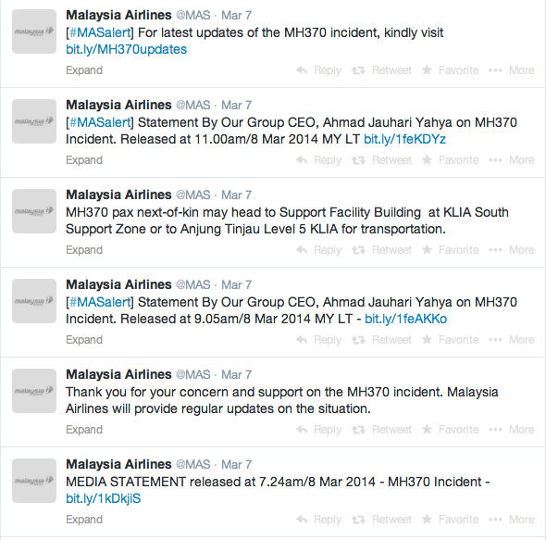
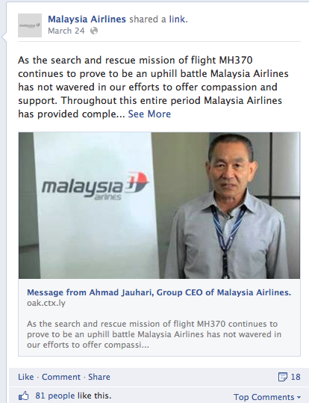
Social Media
Notes:
Fast to update
CEO video didn’t get spread only 47k views

Slide 14
My recommendation
Put the families first
Have one voice
More detailed Press Releases
Connect to journalists and pitch videos
Acknowledge what you are doing
Consider culture
Admit wrongdoings
Enhance the way they are restructuring airline safety

Slide 15
Impact of the crisis
Society
Mystery
Industry
New protocols for Black Box technology
Safety & security
Crisis Communications Plans
Public Relations
How to conduct PR when facts can’t be confirmed
Speed vs. emotions

Slide 16
Questions and comments?
What would you do?

